Slide 1
Visual Cryptography
Another form of secret sharing…
Alice and Bob “share” an image
Both must cooperate to reveal the image
Nobody can learn anything about image from Alice’s share or Bob’s share
That is, both shares are required
Is this possible?

Slide 2
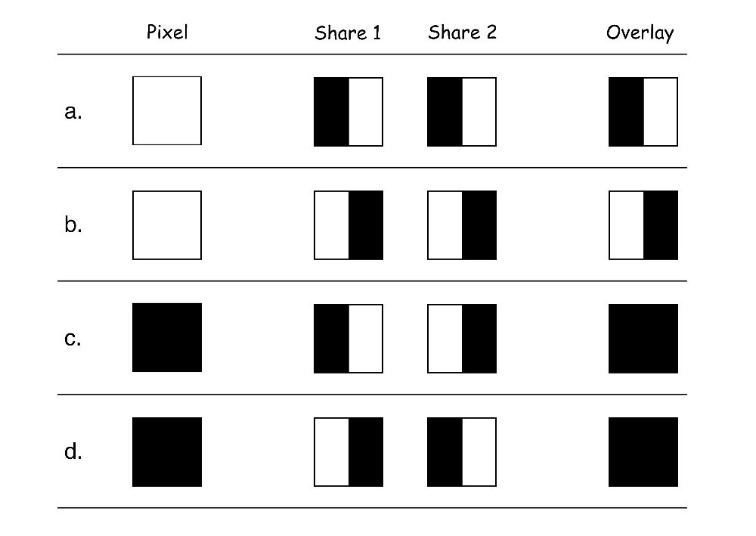
Visual Cryptography
How to “share” a pixel?
Suppose image is black and white
Then each pixel is either black or white
We split pixels as shown

Slide 3
Sharing Black & White Image
If pixel is white, randomly choose a or b for Alice’s/Bob’s shares
If pixel is black, randomly choose c or d
No information in one “share”

Slide 4
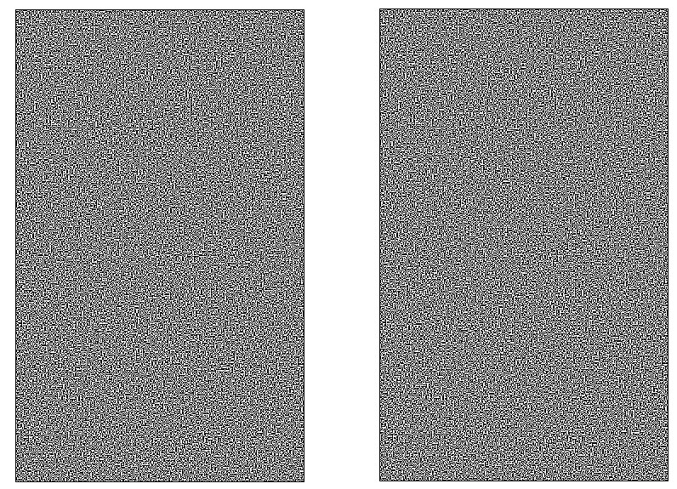
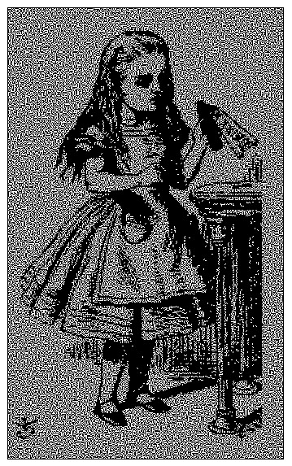
Visual Crypto Example
Alice’s share
Bob’s share
Overlaid shares

Slide 5
Visual Crypto
How does visual “crypto” compare to regular crypto?
In visual crypto, no key…
Or, maybe both images are the key?
With encryption, exhaustive search
Except for the one-time pad
Exhaustive search on visual crypto?
No exhaustive search is possible!

Slide 6
Visual Crypto
Visual crypto ⎯ no exhaustive search…
How does visual crypto compare to crypto?
Visual crypto is “information theoretically” secure ⎯ also true of secret sharing schemes
With regular encryption, goal is to make cryptanalysis computationally infeasible
Visual crypto an example of secret sharing
Not really a form of crypto, in the usual sense

Slide 7
Random Numbers in Cryptography

Slide 8
Random Numbers
Random numbers used to generate keys
Symmetric keys
RSA: Prime numbers
Diffie Hellman: secret values
Random numbers used for nonces
Sometimes a sequence is OK
But sometimes nonces must be random
Random numbers also used in simulations, statistics, etc.
In such apps, need “statistically” random numbers

Slide 9
Random Numbers
Cryptographic random numbers must be statistically random and unpredictable
Suppose server generates symmetric keys
Alice: K_{A}
Bob: K_{B}
Charlie: K_{C}
Dave: K_{D}
Alice, Bob, and Charlie don’t like Dave…
Alice, Bob, and Charlie, working together, must not be able to determine K_{D}

Slide 10
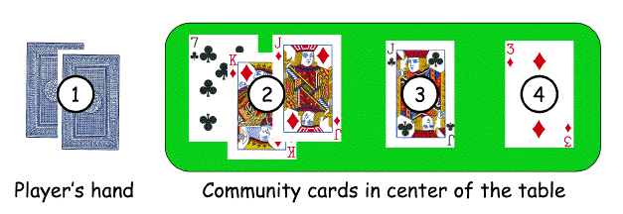
Non-random Random Numbers
Online version of Texas Hold ‘em Poker
ASF Software, Inc.
Random numbers used to shuffle the deck
Program did not produce a random shuffle
A serious problem, or not?

Slide 11
Card Shuffle
There are 52! > 2²²⁵ possible shuffles
The poker program used “random” 32-bit integer to determine the shuffle
So, only 2³² distinct shuffles could occur
Code used Pascal pseudo-random number generator (PRNG): Randomize()
Seed value for PRNG was function of number of milliseconds since midnight
Less than 2²⁷ milliseconds in a day
So, less than 2²⁷ possible shuffles

Slide 12
Card Shuffle
Seed based on milliseconds since midnight
PRNG re-seeded with each shuffle
By synchronizing clock with server, number of shuffles that need to be tested < 2¹⁸
Could then test all 2¹⁸ in real time
Test each possible shuffle against “up” cards
Attacker knows every card after the first of five rounds of betting!

Slide 13
Poker Example
Poker program is an extreme example
But common PRNGs are predictable
Only a question of how many outputs must be observed before determining the sequence
Crypto random sequences not predictable
For example, keystream from RC4 cipher
But “seed” (or key) selection is still an issue!
How to generate initial random values?
Keys (and, in some cases, seed values)

Slide 14
What is Random?
True “random” hard to even define
Entropy is a measure of randomness
Good sources of “true” randomness
Radioactive decay ⎯ but, radioactive computers are not too popular
Hardware devices ⎯ many good ones on the market
Lava lamp ⎯ relies on chaotic behavior

Slide 15
Randomness
For randomness we do not want a external device
Sources of randomness via software
Software is supposed to be deterministic
So, must rely on external “random” events
Mouse movements, keyboard dynamics, network activity, etc., etc.
Can get quality random bits by such methods
But quantity of bits is very limited
Bottom line: “The use of pseudo-random processes to generate secret quantities can result in pseudo-security”

Slide 16
Information Hiding

Slide 17
Information Hiding
Digital Watermarks
Example: Add “invisible” info to data
Defense against music/software piracy
Steganography
“Secret” communication channel
Similar to a covert channel (more later)
Example: Hide data in an image file

Slide 18
Watermark
Add a “mark” to data
Visibility (or not) of watermarks
Invisible ⎯ Watermark is not obvious
Visible ⎯ Such as TOP SECRET
“Strength” of watermarks
Robust ⎯ Readable even if attacked
Fragile ⎯ Damaged if attacked

Slide 19
Watermark Examples
Add robust invisible mark to digital music
If pirated music appears on Internet, can trace it back to original source of the leak
Add fragile invisible mark to audio file
If watermark is unreadable, recipient knows that audio has been tampered with (integrity)
Combinations of several types are sometimes used
E.g., visible plus robust invisible watermarks

Slide 20
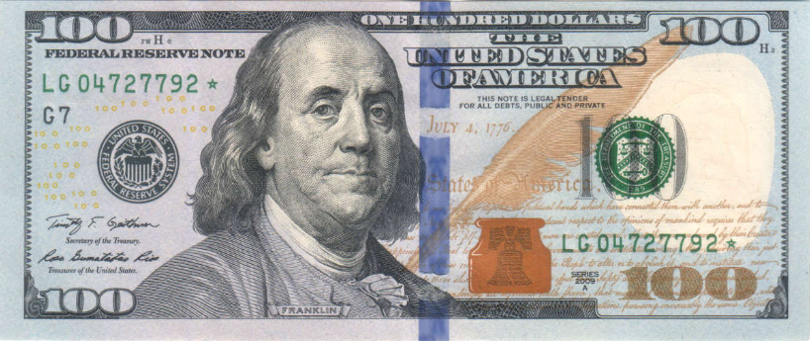
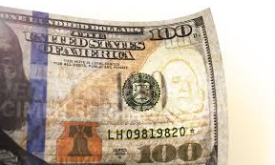
Watermark Example (1)
Non-digital watermark: U.S. currency
Hold bill to light to see embedded info

Slide 21
Watermark Example (2)
Add invisible watermark to photo
Claim is that 1 inch² contains enough info to reconstruct entire photo
If photo is damaged, watermark can be used to reconstruct it!

Slide 22
Steganography
According to Herodotus (Greece 440 BC)
Shaved slave’s head
Wrote message on head
Let hair grow back
Send slave to deliver message
Shave slave’s head to expose a message warning of Persian invasion
Historically, steganography used by military more often than cryptography

Slide 23
Images and Steganography
Images use 24 bits for color: RGB
8 bits for red, 8 for green, 8 for blue
For example
0x7E 0x52 0x90 is this color
0xFE 0x52 0x90 is this color
While
0xAB 0x33 0xF0 is this color
0xAB 0x33 0xF1 is this color
Low-order bits don’t matter…

Slide 24
Images and Stego
Given an uncompressed image file…
For example, BMP format
…we can insert information into low-order RGB bits
Since low-order RGB bits don’t matter, changes will be “invisible” to human eye
But, computer program can “see” the bits

Slide 25
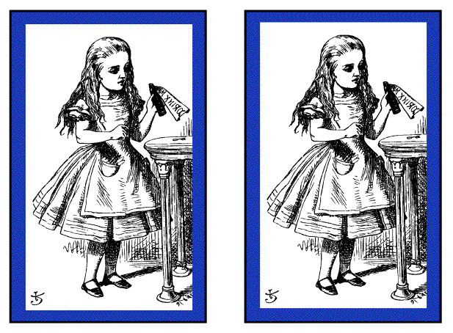
Stego Example 1
Left side: plain Alice image
Right side: Alice with entire Alice in Wonderland (pdf) “hidden” in the image

Slide 26
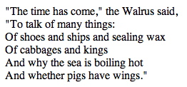
Non-Stego Example
Walrus.html in web browser
“View source” reveals:
<font color=#000000>"The time has come," the Walrus said,</font><br>
<font color=#000000>"To talk of many things: </font><br>
<font color=#000000>Of shoes and ships and sealing wax </font><br>
<font color=#000000>Of cabbages and kings </font><br>
<font color=#000000>And why the sea is boiling hot </font><br>
<font color=#000000>And whether pigs have wings." </font><br>

Slide 27
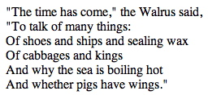
Stego Example 2
stegoWalrus.html in web browser
“View source” reveals:
<font color=#000101>"The time has come," the Walrus said,</font><br>
<font color=#000100>"To talk of many things: </font><br>
<font color=#010000>Of shoes and ships and sealing wax </font><br>
<font color=#010000>Of cabbages and kings </font><br>
<font color=#000000>And why the sea is boiling hot </font><br>
<font color=#010001>And whether pigs have wings." </font><br>
“Hidden” message: 011 010 100 100 000 101

Slide 28
Steganography
Some formats (e.g., image files) are more difficult than html for humans to read
But easy for computer programs to read…
Easy to hide info in unimportant bits
Easy to damage info in unimportant bits
To be robust, must use important bits
But stored info must not damage data
Collusion attacks are also a concern
Robust steganography is tricky!

Slide 29
Information Hiding: The Bottom Line
Not-so-easy to hide digital information
“Obvious” approach is not robust
Stirmark: tool to make most watermarks in images unreadable without damaging the image
Stego/watermarking are active research topics
If information hiding is suspected
Attacker may be able to make information/watermark unreadable
Attacker may be able to read the information, given the original document (image, audio, etc.)

